Slide 1
Family Law: Legal Rules and Family Values
Ira Mark Ellman, College of Law, Arizona State University
Sanford L. Braver, Department of Psychology, Arizona State University
Robert J. MacCoun, Goldman School of Public Policy, Berkeley
Nuffield Foundation, London
October 29, 2010
1
© 2009
Ira Ellman and Sanford Braver

Slide 2
Overview
Description of the General Project
  What we hope to learn
  How we plan to learn it
  How our findings relate to legal rules
A Detailed Example: Child Support Guidelines
  Primer on the law
  Our data
A Window into Other findings
  Alimony
  Other issues we have asked about
2

Slide 3
What We Hope to Learn
Are there principles animating people’s views about the appropriate outcome in a legal dispute? If so, what are they?
A Principle could be either
  statement of a rule or policy directing how a case should be decided
  statement fairly summarizing decision patterns revealed in cases actually put
Are the principles folks actually employ in cases the same as those they say they believe in?
3

Slide 4
Multiple Principles May Apply
People may widely agree on principles that should govern, but disagree about
  their relative importance
  the facts required to trigger application
    E.g. income disparity matters—but how much?
We hope to discover both
  What most people agree on
  What predicts their differences when they do not agree
4

Slide 5
Overview
Description of the General Project
  What we hope to learn
  How we plan to learn it
  How our findings relate to legal rules
A Detailed Example: Child Support Guidelines
A Window into Other findings
  Alimony
  Other issues we have asked about
5

Slide 6
Our Method
Ask about principles directly?
  We sometimes do, but never alone
Ask about cases? Our main method
  more akin to the common law:
  we try to discern the principles they employ from how they decide these cases.
Do the 2 methods yield different results?
  Somewhat
  And asking about cases affects what people say about principles
6

Slide 7
Constructing Case Vignettes
7
One must vary vignette facts systematically along dimensions chosen with particular rules in mind.
So the first task: choose the principles to ask about.
More concrete rules are easier to investigate via vignettes

Slide 8
Concrete versus Abstract Rules:
Compare Two Versions of a Principle
1. “Alimony is appropriate only when a couple have shared their life so fully, and invited such reliance on one another, that one of them becomes responsible to share in the disproportionate losses suffered at separation by the other.”
8

Slide 9
Compare, continued
9
2. “The longer the couple has been together, the stronger is the alimony claim.”
The more concrete version
  Requires less judicial gloss to apply
  Easier to tell whether a respondent’s decisions are consistent with it
  May be the operational equivalent of the first, more abstract, principle

Slide 10
Can One Test More Abstract Propositions?
They can be included in Likert items that accompany the vignettes
One can then ask
  Do respondent ratings of these broader principles predict their resolution of cases?
  If so, is the connection logical?
10

Slide 11
Overview
Description of the General Project
  What we hope to learn
  How we plan to learn it
  How our findings relate to legal rules
A Detailed Example: Child Support Guidelines
  Primer on the law
  Our data
A Window into Other findings
  Alimony
  Other issues we have asked about
11

Slide 12
Intact Families and Dissolving Families
Intact family relations governed largely by emotions and norms, not law
  more powerful than law in compelling compliance.
  but their power fails when families divide
  Should the law therefore try to buttress them?
Or do different norms apply?
  This is our question
  We ask: are there norms as to the appropriate legal rules at dissolution?
12

Slide 13
More on Norms
We do not ask what people should do after the relationship ends
We ask them what the law should require people to do
  Made clear because they are asked to imagine themselves a judge deciding a case
An alternative to high theory, as a rationale for legal rules that impose family obligations at dissolution
13

Slide 14
Two kinds of reasons for Rules
Social engineering: rules designed to change behavior in the future
  Incentives and deterrence
  Economics
Fairness: rules designed to change the consequences of an event that already occurred
  Philosophy, jurisprudence, high theory
Our data speak only to the second reason
14

Slide 15
Overview
Description of the General Project
  What we hope to learn
  How we plan to learn it
  How our findings relate to legal rules
A Detailed Example: Child Support Guidelines
  Primer on the law
  Our data
A Window into Other findings
  Alimony
  Other issues we have asked about
15

Slide 16
What should Guidelines do? 4 Principles to Balance
Ensure Child Well-Being
  Especially important at low CP incomes
Ensure both parents pay: Dual Obligation
Protect Child from Disproportionate Loss
  Prevent Gross Disparities in outcomes—relevant in highest income cases especially
Treat the obligor fairly
  Earner’s Priority Principle
  Especially relevant to low income NCPs
16

Slide 17
What Do Current Guidelines Do?
Guidelines focus on parental incomes and the number of children
Guideline amounts based on estimates of the marginal expenditures on children in intact families
Separated Dad pays Mom his proportionate share of those marginal expenditures
Why marginal expenditures?
17

Slide 18
Marginal Expenditures?
The idea
  Mom alone pays her base expenditures: housing, food, transportation, etc
  Dad pays his share of the additional expenditures: extra bedroom, extra food, etc.
The reality with disparate parental incomes
  Low income mom gets help for extra bedroom
    but cannot afford kitchen or bathroom
  Low income dad pays nontrivial amount to middle class mom who lives better than him before any support payment
18

Slide 19
Example
Marginal expenditure, 1 child, family income $3,000: $589, or 19.6%.
Assume Mom earns $500, and Dad earns $2500
Dad must pay Mom 5/6 share of $589, or $491
  Mom and child have $500 + $491 = $991
    Less than poverty threshold
  Dad has $2500 - $487 = $2009—lives better than when family was intact
  Arizona: actual required payment after PA is $396.
What if Dad earns $500?
  He pays 1/6 of $589, or $98.
  Can he afford this? Does it help the child much?
19

Slide 20
Overview
Description of the General Project
  What we hope to learn
  How we plan to learn it
  How our findings relate to legal rules
A Detailed Example: Child Support Guidelines
  Primer on the law
  Our data (I. Cases; II. Principles)
A Window into Other findings
  Alimony
  Other issues we have asked about
20

Slide 21
Who We Asked: Tucson Jury Pool
  Total N of 1435 taken over four weeks
  Subgroup of 262 completed Name and Choose questions
  65% to 70% response rate to long forms
Demographic breakdown of respondents
  55% were women
  62% were married, 35% were divorced
  69% had children
  12% had paid support, 18% had received it
  97% graduated high school, 25% had B.A.
  5.6% earned less than $15,000
  46% earned more than $60,000
21

Slide 22
What We Asked, Part I (Cases)
Every case (in this run) shared these facts
  One child (9 year old boy)
  Mom is CP, Dad is support obligor
  Son “lives mostly with Mom, but Dad sees him often”
The cases differed only in parental incomes
  Dad earns $6000, $4000, or $2000 a month in “take-home pay”.
  Mom: $5,000, $3,000, or $1,000
Everyone asked about all nine of the income combinations
One group named their number, another chose
22

Slide 23
The Precise Question
We want to know the amount of child support, if any, that you think Dad should be required to pay Mom every month, all things considered. What will change from story to story is how much Mom earns, and how much Dad earns. There is no right or wrong answer; just tell us what you think is right. Try to imagine yourself as the judge in each of the following cases. Picture yourself sitting on the bench in a courtroom needing to decide about what should be done about ordering child support in the case and trying to decide correctly. To do so, you might try putting yourself in the shoes of Mom or of Dad or both, or imagine a loved one in that position.
23

Slide 24
Respondents’ Mean Child Support Amounts
1. 3 lines: so Mom’s income matters (POOI implicitly rejected)
2. Not just higher amounts, but higher rates as Mom’s income goes down (steeper slopes)
Low income mom
High Income mom
24
Notes:
This slide shows respondents believe
1. There are three lines rather than one line, which means respondents reject POOI
2. Steeper slope for lower income moms means that respondents believe
a. When mom earns less, Dad should not only pay more, he should pay a higher proportion of his income
b. Steeper slope for low income moms means that respondents are particularly inclined to demand higher
3. Real key: respondents believe rates should fall as Mom’s income rises—but NOT as Dad’s income rises

Slide 25
Lesson One
Does Mom’s income matter, or only Dad’s?
  Our respondents reject POOI: They believe that as Mom’s income goes up, the rate applied to Dad’s income should go down
“Income Shares” states like Arizona believe in declining rates for Dad as his income goes up.
  Do our respondents?
No. See next chart
25

Slide 26
Support Payment as Percent of Dad’s Income:
Mom’s Income is $1,000 monthly
26

Slide 27
Support Payment as Percent of Dad’s Income:
Mom’s Income is $3,000 monthly
27

Slide 28
Support Payment as Percent of Dad’s Income Mom’s Income is $5,000 monthly
28

Slide 29
Rate Rules
Method | As Mom’s Income Rises | As Dad’s Income Rises
POOI | Unchanged | Unchanged
Income Shares | Go Down | Go Down
Pima County Citizens | Go Down | Unchanged
29

Slide 30
Key Points on Rates
“Flat tax” preferred for child support
  But a higher flat tax on Dad when Mom’s income is lower
  This is neither POOI nor Income Shares
This rate structure preferred by men and women:
But how do the actual support amounts compare to existing guidelines?
30

Slide 31
Middle Cell: Identical
Top Row (Poor Moms): Public wants higher amounts
Bottom Row (Comfortable Moms) Public wants lower amounts.
Ears: Same pattern—lower earner favored
31

Slide 32
Key Points on Amounts
Respondents favor higher support amounts than Arizona demands
Compared to Iowa: they want
  Higher amounts for low-income CPs
  Lower amounts for high-income CPs
  Seems consistent with both Well-Being, EPP and Dual Obligation
But: What about the variability in our respondents’ answers?
32

Slide 33
“Coherent Arbitrariness”
Considerable variability from person to person in height—
Y-Intercept -- of the line describing their support guideline.
  95% confidence interval is $249 to $366
Very little variability in the slopes—the change they make in the amount from support, as income changes
  CP income = -$82 per $1000 increase
    95% confidence interval is -89 to -75
  NCP income = $185 per $1000
    95% confidence interval of 177 to 193
Ariely called this pattern “coherent arbitrariness”
  The Initial choice seems arbitrary
  But once the choice is made, later choices are coherently related to it.
But is the initial choice really arbitrary? We will examine.
  Some of the variability gender related—next slide
  Some related to differing beliefs about principles—next section
33

Slide 34
Mom has
$5000
Mom has
$1000
Mom has
$3000
34

Slide 35
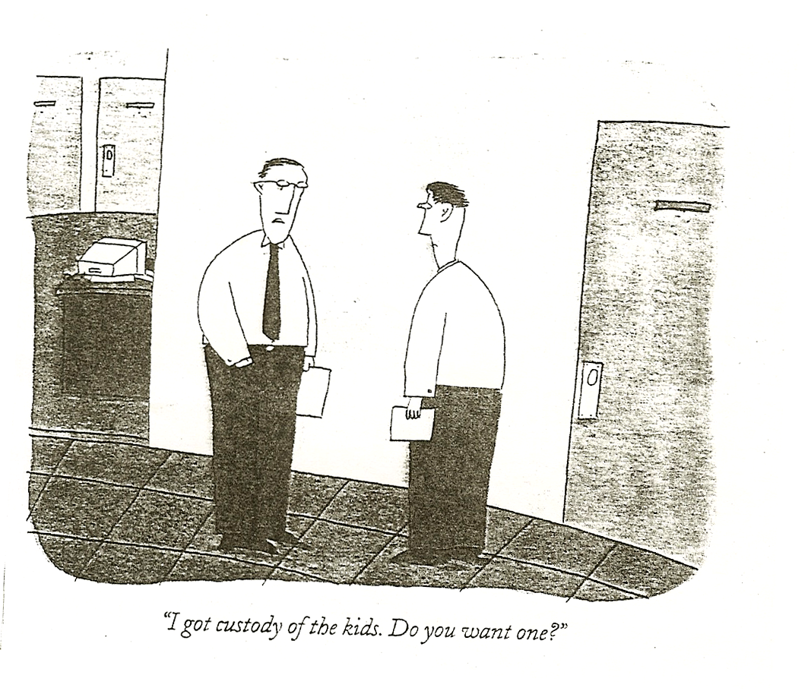
Why Do the Genders Differ?
Of the 30% in the child support system, nearly all Obligors were men, nearly all CP’s women
35

Slide 36
What We Ask II: Principles
Twenty Likert Items—seven point scale
Intended to measure ten principles
  Four (from Theory of Child Support)
  Six from other sources
    Feminist writings
    Father’s groups
    Existing statutes (POOI)
First, some examples of individual items
36

Slide 37
Likert Items 1 through 3
Item | % Who Clearly Agree | % Who Clearly Disagree | Men or Women Agree More?
CHILD WELL-BEING
The most important reason to require child support payments is to ensure the well-being of children. | 92.6 (1) | 1.4 | No Diff
GROSS DISPARITY
The father should be required to pay only the child support amount needed to make the child completely comfortable, even if the father has a high income and lives much better than the child.‡ | 21.6 | 37.9 | Men (.70)
If the father has a lot more money than the mother has, he should pay enough child support to make sure the child doesn't live too much worse than he lives. | 57.2 (5) | 7.2 | Women (.65)
37

Slide 38
Likert Items 7 through 9
Item | % Who Clearly Agree | % Who Clearly Disagree | Men or Women Agree More?
DUAL-OBLIGATION
Even if the mother has enough money to provide the child with everything that might be important to the child's well-being, the father should still have to pay some child support. | 69.2 (3) | 7.1 | Women (.77)
The mother should receive child support payments from the father even if she can meet the child's basic physical and educational needs without them. | 58.7 (4) | 7.7 | Women (.74)
When the mother has enough money to support the child fully, the father should not have to pay child support at all.‡ | 8.1 | 72.4 | Men (.90)
38

Slide 39
Likert Items 17-20
Item | % Who Clearly Agree | % Who Clearly Disagree | Men or Women Agree More?
ENSURE MARITAL LIVING STANDARD
The father should be required to pay enough child support to make sure that the child lives as well as he or she did during the marriage. | 45.4 | 12.5 | Women (.93)
ENSURE EQUAL LIVING STANDARD
The father should be required to pay enough to make sure that the child lives as well as he does. | 46.7 | 11.6 | Women (.90)
The father should be required to pay enough to make sure that the child and mother live as well as he does. | 31.1 | 22.6 | Women (.72)
The purpose of child support is not to make sure the child lives as well as the father.‡ | 36.1 | 27.4 | Men (.46)
39

Slide 40
Analyzing the Likert items
How to get a handle on results from 20 different items?
Ask: Are there patterns in the way people answer individual items?
Do these patterns reveal some smaller set of attitudes—factors—that explain their answers to the full set of questions?
Method: Exploratory Factor Analysis
Finding: Four factors explain more than half the variance
40

Slide 41
EFA explains 52%
1 = GD+
  Mean rating = 4.99
2 = Dual Obligation
  Mean rating = 4.82
41

Slide 42
Factors 3 & 4
3: Limiting Father’s Responsibility
  Most disagree: mean rating 2.81
4: Earner’s Priority
  Highest average agreement of all: 5.69
42

Slide 43
Gender Effects in Factors 1 & 2
43
Notes:
Significant differences between any two points—at what level?

Slide 44
Do the Principles People Endorse
Predict the Support Amounts They Prefer?
Most studies look at either beliefs about principles, or cases, but not both
None systematically examine the relationship between them
But in life—and Law--we constantly make assumptions about that relationship
  On one hand, we think people should be consistent
  On the other hand, we may doubt they really are
We use HLM analysis to ask whether any of our Factors contributes independently of the others to predicting a respondent’s favored support amount
44

Slide 45
HLM Analysis: Basic Result
45
The first 3 Factors (GD+, DO, LimFatherRes) all entered the simultaneous regression
Implying that each makes an independent unique significant contribution to support judgments
Factor 4, EPP, does not enter or predict resolution of cases, so you’ll hear no more about it.
Different patterns of results with the different Factors

Slide 46
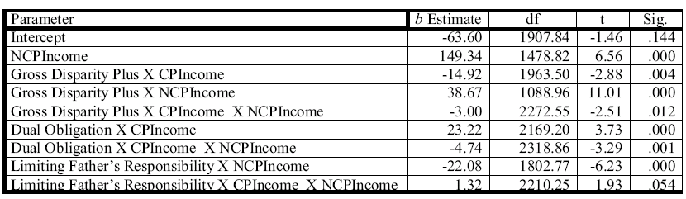
Significant Coefficients from the HLM
GD+ interacts with both incomes and their interaction
DO interacts with CP Income, and the interaction of CP and NCP income, but not NCP Income alone.
LimFatherRes interacts with NCP Income and the interaction of CP and NCP income, but not CP Income alone
46

Slide 47
Method for Relating Cases to Principles
Compute the average Likert rating respondents give to the items that constitute each factor.
Using HLM, compute the fitted support amount for respondents whose Likert rating for Factor X is
  1 SD above the mean rating for that Factor (while at the mean for the other factors) (High Factor X),
  1 SD below the mean rating for that Factor, (while at the mean for the other factors) (Low Factor X)
Question: Do the differences in the support amounts between strong and weak endorsers (high and low) of a principle follow logically from their positions on that principle?
47

Slide 48
Gross Disparity+ as Predictor of Child Support Amounts
Mother’s Income: ▲= 5000 ■ = 3000 ● = 1000
Gross Disparity +: Low High
Father’s Income

Slide 49
What Prior Slide Tells Us
Both groups show same basic pattern:
  CS amounts go down as CP income rises
  CS amounts go up as NCP income rises
But strong endorsers of GD principle
  Prefer more CS at every point, (Y-intercept)
  Raise support amounts more rapidly with increasing NCP income (steeper slope)
    Yields greatest premium over weak endorsers for the cases with the greatest income disparity
Exactly the pattern one should expect from the group that cares more about Income Disparity
49

Slide 50
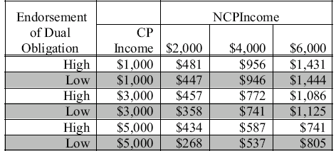
Dual Obligation & Support Amounts
Strong endorsers should impose higher amounts on Low-income NCPs than do weak endorsers
No reason for strong endorsers to favor higher amounts for High-income NCPs
Strong endorsers care more about ensuring NCP’s pay something, than about closing disparity. (stars on higher amounts)
50

Slide 51
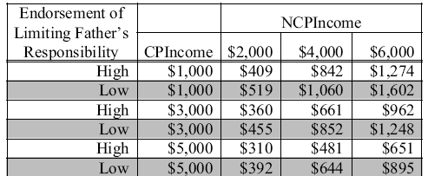
Limiting Dad’s Responsibility & Amounts
What difference in amounts would you expect for those high on Limiting Father’s responsibility?
  generally lower support amounts (stars), but
  Especially in cases of high income Dads and low income Moms—opposite GD+
Remember: the three factor effects are independent
51

Slide 52
Cases and Principles: Conclusions
Remarkable consistency between them
  Rs not given a deductive exercise (they were not asked to apply principles to cases)
  Each R asked only what he or she thought was right amount
  They were asked about principles after deciding cases
The Principles we infer (“capture”) from cases are intuitive and unarticulated—but there.
Likert items uncover much, but perhaps not all, of these unarticulated principles
52

Slide 53
Cases and Principles: Conclusions continued
Respondent ratings of principles helps explain the pattern of support amounts:
  Arbitrariness reduced:
    Much of the variability in Y-intercepts—starting points—is a function of differences in attitudes toward basic principles.
    It is not random or arbitrary.
  Coherence increased:
    What little variability there is in slope--relative judgments--is also a function, in part, of differences in attitudes toward basic principles. It is not random.
53

Slide 54
Overview
Description of the General Project
  What we hope to learn
  How we plan to learn it
  How our findings relate to legal rules
A Detailed Example: Child Support Guidelines
A Window into Other findings
  Alimony
  Other issues we’ve asked about
54

Slide 55
Alimony: What We Tell Them
Not child support
Judges don’t always agree with each other about
  Whether there should alimony
  If so, how much
  Whether marriage required
55

Slide 56
What We Tell Them, continued
We want to know what you think the judge should decide.
No right or wrong answer.
You may think alimony appropriate in some cases but not in others.
Or, you may think that all the cases should be decided the same way.
Either is fine. We just want to know what you think is right.
56

Slide 57
Alimony: How the Vignettes Varied
Marital status: married or cohabiting
Relationship duration: 6 or 22 years
Children: 3 conditions
  None
  Grown, mom had been primary caretaker
  Young, 4 & 6 years old, mom is PC
    Child support amount, high or low
Parental incomes (see next slide)
57

Slide 58
Income Variation
58
Woman was $1,000 or $3,000
Man was $6,000 or $12,000
  These amounts were described as “take home pay”
Every respondent was asked about all four income combinations

Slide 59
The Question
Should the court require Adam to pay alimony to Eve? Tell us what you think:
  No, Adam should not have to pay any alimony to Eve.
  Yes, Adam should have to pay alimony to Eve.
For those answering Yes:
How Much? Adam should pay Eve $_______ a month
59

Slide 60
Some summary results:
Most people believe there are cases in which alimony is appropriate
Most believe it is sometimes appropriate for cohabitants
Most believe it is appropriate where income disparity is high, even if the claimant earns enough on her own to have a middle class status
60

Slide 61
Summary results continued
For Most, alimony more often appropriate:
For a married couple
  but still allow it to some cohabitants
When couple together 22 years
  but still allow it to some together only 6
When there are young children
  But still allow it to some childless
  Grown children matter much less
  Marriage matters less when there are children
When child support amounts are lower
61

Slide 62
Summary results continued
Individual Differences Muted:
The patterns are the same for
  men and women
  higher and lower income individuals
  Self-identified conservatives and liberals
  Self-identified Democrats and Republicans
  Those divorced and those not
E.g., the marriage premium, or the young child premium, no different for men than for women
But the total curve slightly higher for
  Women
  Older respondents (but marriage premium the same)
62

Slide 63
What About the Amount of the Alimony Award?
Nothing matters but the
  partners’ incomes
Man’s income mattered much more
  than woman’s income
Key: the disparity in income
63

Slide 64
Other Issues: Child Support
Does it Matter how much time Dad has?
  Yes: declines linearly with increasing visitation (0, 5, 10, 15 days per month)
  Impact of visitation time same for men and women respondents
  These results assume parents agreed on time
If Dad doesn’t see child at all? Depends on why
Take $1100 baseline (agreed schedule, above)
  When Dad moves away: +211
  Mom refused to let him see child: -31
  Mom moves over Dad’s objection: -200
  Custodial Dad moves, mom objects: -383

Slide 65
Other issues continued
Child Support
  Does marriage matter?
    Yes for higher income NCP’s
  Does Duration of relationship matter?
    one night, 4 years, 15 years
    Big impact on the unmarried
Property Allocation
  Marital roles?
  Fault for the marital breakup?
  Very high income?
Gender reversals in many cases

Slide 66
The End?

Slide 67
Child Support as a Function of Agreed-Upon Visitation

Slide 68
Child Support as Function of Reason for Non-Visitation

Slide 69
Child Support Award as Function of NCP Income, Married v. Cohabiting Couples

Slide 70
Child Support Award as Function of Relational Duration, Unmarried Parents

Slide 71
Alimony As Function of Marital Status and Children

Slide 72
Alimony as Function of Relation Duration and Children

Slide 73
Alimony Amount as Function of Partner Incomes

